Slide 1
$ ./run_tests.sh --target automationexercise.com
[✓] Environment ready [✓] WebDriver loaded [✓] Test suite compiled
QA
mission_brief.txt
PROJECT Automation Exercise E-Commerce QA Suite STACK Selenium + Java + TestNG Chrome 148 · Windows 10/11 TEAM
Ahmad · Basil
Hamza · Mohammed
AUTOMATION
TESTING PROJECT
QA AUTOMATION BOOTCAMP · automationexercise.com · 26 TEST CASES · 4 MODULES

Slide 2
01 /
OVERVIEW
IN SCOPE
Project
Overview
Authentication Module
Product Discovery & Search
Cart State Management
Checkout & Payment Flow
TARGET
automationexercise.com
UI Layout Validation
TYPE
Contact Form & File Upload
Functional + UI Regression
APPROACH
Automation (Selenium/Java)
OUT OF SCOPE
PATTERN
Page Object Model (POM)
Real Payment Processing
BROWSER
Chrome 148 · Windows 10-11
Backend Performance / Load Testing

Slide 3




02 /
TEAM
TEAM & MODULE OWNERSHIP
Module 1
Module 2
Module 3
Module 4
AHMAD
BASIL
HAMZA
MOHAMMED
Authentication
Specialist
Navigation
Engineer
Cart & Commerce
Tester
Checkout & UI
Validator
6 TEST CASES
6 TEST CASES
6 TEST CASES
8 TEST CASES
Login Flows · Session Mgmt
Search Engine · Category
Cart Logic · Subscription
Payment Flow · UI Grid

Slide 4
03 / AUTHENTICATION MODULE
OWNER: AHMAD
Covers user registration, login flows, session management, and account deletion.
auth_tests.log
TC-AUTH-001
New User Registration
POSITIVE
Account created · ACCOUNT CREATED! message shown · Navbar updates to show username
TC-AUTH-002
Login with Valid Credentials
POSITIVE
User logged in successfully · Logged in as [Username] visible in header
TC-AUTH-003
Login with Invalid Credentials
NEGATIVE
Expected error displayed: 'Your email or password is incorrect!'
TC-AUTH-004
User Logout
POSITIVE
Session cleared · User redirected to the unauthenticated landing page
TC-AUTH-005
Register with Existing Email
NEGATIVE
Expected error displayed: 'Email Address already exist!'

Slide 5
04 / PRODUCTS
OWNER: Basil
MODULE 2 · BASIL
Products & Navigation
TC-PROD-001
All products and item Detail Page
Name, price, stock, brand — all load correctly
TC-PROD-002
Global Text Search
'Top' → SEARCHED PRODUCTS header
TC-PROD-003
Category Traversal
Women → Dresses sidebar navigation verified
Men → Tshirts sidebar navigation verified
TC-PROD-004
Brand Filtering
Polo / H&M brand pages load with correct heading

Slide 6
05 / CART & CHECKOUT
OWNER: Basil
MODULE 3 · HAMZA
🛒 TC-CART-001
ADD ITEM
💳 TC-CART-002
CART
Add Product to Cart
Product quantity
Products button → Add first product to Cart → Continue Shopping → Add second product to Cart → Verify both products are added and match their details
Choose a product → Add to Cart 4 times → Go to Cart page → Verify product is displayed with quantity 4
🖥️ TC-CART-003
ITEM REMOVAL
📎 TC-CHK-004
SEARCH
Remove Product
Search Item and Verify Cart
Add any product to Cart → Go to Cart page → Click X button for a particular product → Verify product is removed from cart
Enter Product name “Top” → Add some products to Cart → Go to Cart page → Verify they are in Cart → Make Login → Go to Cart page again → Verify they are still in Cart

Slide 7
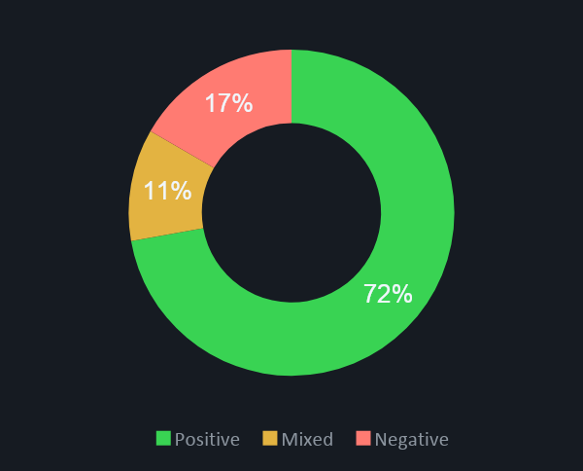
06 /
TEST RESULTS DASHBOARD
OWNER: Hamza
26
4
HIGH
POM
TOTAL TESTS
MODULES
ALL PRIORITY
ARCHITECTURE
TEST TYPE MIX

Slide 8
08 / RISKS & MITIGATIONS
OWNER: Hamza
⚡
Ad / Popup Interference
MED
MITIGATION:
Popup utility methods + explicit element waits + try-catch wrapping
🔄
Chrome Version Drift
LOW
MITIGATION:
Pin WebDriverManager to v148; update map before each sprint
🎞️
Dynamic UI Animations
MED
MITIGATION:
Fluent waits + explicit visibility conditions before interactions
👥
Shared Test Accounts
HIGH
MITIGATION:
Module-isolated test data; account teardown after each test run
🌐
Platform Downtime
LOW
MITIGATION:
3-retry logic + daily health-check script pre-execution

Slide 9
07 / TECH STACK & ENVIRONMENT
OWNER: Mohammad
environment.config
>
selenium-webdriver
Browser automation engine — drives Chrome interactions
v4.x
>
java
Primary programming language for all test scripts
JDK 11+
>
testng
Test framework — annotations, grouping, parallel execution
v7.x
>
maven
Build tool & dependency manager — pom.xml config
v3.x
>
chrome-driver
WebDriver binary synced with Chrome 148 (Windows 10)
v148
>
page-object-model
Separation of locators & actions from test logic (POM)
Design

Slide 10
OWNER: Mohammad
[26/26] Test cases executed
[4/4] Modules covered
[✓] All test cases — Mix Priorities
[✓] Page Object Model architecture applied
All scenarios validated successfully.
THANK YOU
AHMAD · BASIL · HAMZA · MOHAMMED
QA AUTOMATION BOOTCAMP · automationexercise.com

